Slide 1

“CampusLearn”
Project Presentation
Raj Dugane(ADT23SOCBD141 )
Trusha Salode (ADT23SOCBD077)
Guided by
Prof. Abhijeet Cholke
Department of Computer Science & Engineering, MITSoC, Loni Kalbhor

Slide 2

Outline
Introduction
Problem Statement
Objectives
Features and Technology used
Literature Review
Implementation
Reference
Department of Computer Science & Engineering, MITSoC, Loni Kalbhor

Slide 3
Introduction
CampusLearn is a web-based learning platform for students.
Provides course → semester → subject-wise materials.
Includes notes, PPTs, videos, and discussions.
Built with modern React architecture
Department of Computer Science & Engineering, MITSoC, Loni Kalbhor

Slide 4
Problem Statement
Study materials are scattered across WhatsApp, Drive, etc.
No proper organization or easy access.
Difficult for students to find relevant and updated content.
Objectives
Centralize all study materials in one platform
Provide structured access (Course → Subject)
Enable student & admin roles
Improve learning efficiency and accessibility
Department of Computer Science & Engineering, MITSoC, Loni Kalbhor

Slide 5
Features and Technology Used
Features
Student & Admin Login
Subject-wise Materials (Notes, PPT, Videos)
Search & Filter System
Student Discussion Forum
Admin Dashboard & Analytics
Fully Responsive UI
Technology Used
Frontend: React.js + Vite
Styling: Tailwind CSS
Database: Supabase
Routing: React Router
Department of Computer Science & Engineering, MITSoC, Loni Kalbhor

Slide 6
Literature Survey
Sr. no | Literature Title | Author | Findings
1. | Online Learning Management Systems: Adoption and Challenges in Higher Education | Kumar, A., & Gupta, R. | • LMS platforms centralize learning materials, improving student engagement. • Key challenges include low adoption due to poor user experience. • Simplified design and responsive UI enhance accessibility..
2. | The Impact of Digital Platforms on Academic Resource Sharing | Mehta, S., & Verma, K. | • Digital repositories help students access updated materials efficiently. • Real-time data synchronization improves learning continuity. • Data organization by course and subject reduces redundancy.
3. | Role of Web Technologies in Enhancing Higher Education | Sharma, N., & Patel, D. | • Integration of web-based tools promotes collaboration among students and faculty. • Cloud storage and real-time databases improve scalability and reliability. • Responsive design supports cross-device learning (mobile + desktop).
Department of Computer Science & Engineering, MITSoC, Loni Kalbhor

Slide 7
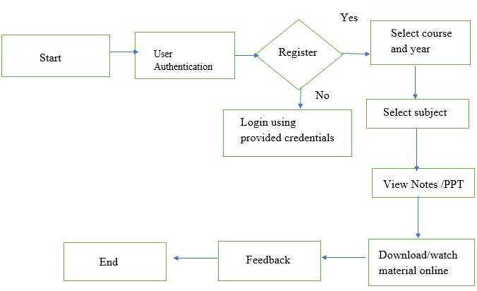
Implementation
Department of Computer Science & Engineering, MITSoC, Loni Kalbhor

Slide 8
Results
Faster access to study materials
Organized academic content
Easy admin control
Improved student experience
Department of Computer Science & Engineering, MITSoC, Loni Kalbhor

Slide 9
Conclusion and Future Work
CampusLearn successfully addresses the problem of scattered educational resources by providing a real-time, centralized, and user-friendly academic portal.
In the future, the platform will:
Add faculty upload verification system
Introduce AI-powered resource recommendations
Implement discussion forums for student interaction
Develop a mobile app for offline content access
CampusLearn sets the foundation for a digital academic ecosystem that enhances learning efficiency and fosters collaboration.
Department of Computer Science & Engineering, MITSoC, Loni Kalbhor

Slide 10
References
https://www.researchgate.net/publication/Online_Learning_Management_Systems_in_Higher_Education
https://ieeexplore.ieee.org/document/8763452
https://www.sciencedirect.com/science/article/pii/S1877042814050212
https://elearningindustry.com/importance-of-online-learning-portals-in-education
Department of Computer Science & Engineering, MITSoC, Loni Kalbhor

Slide 11
Thank You
Department of Computer Science & Engineering, MITSoC, Loni Kalbhor

